Slide 1
MIS547
Cloud Computing

Slide 2
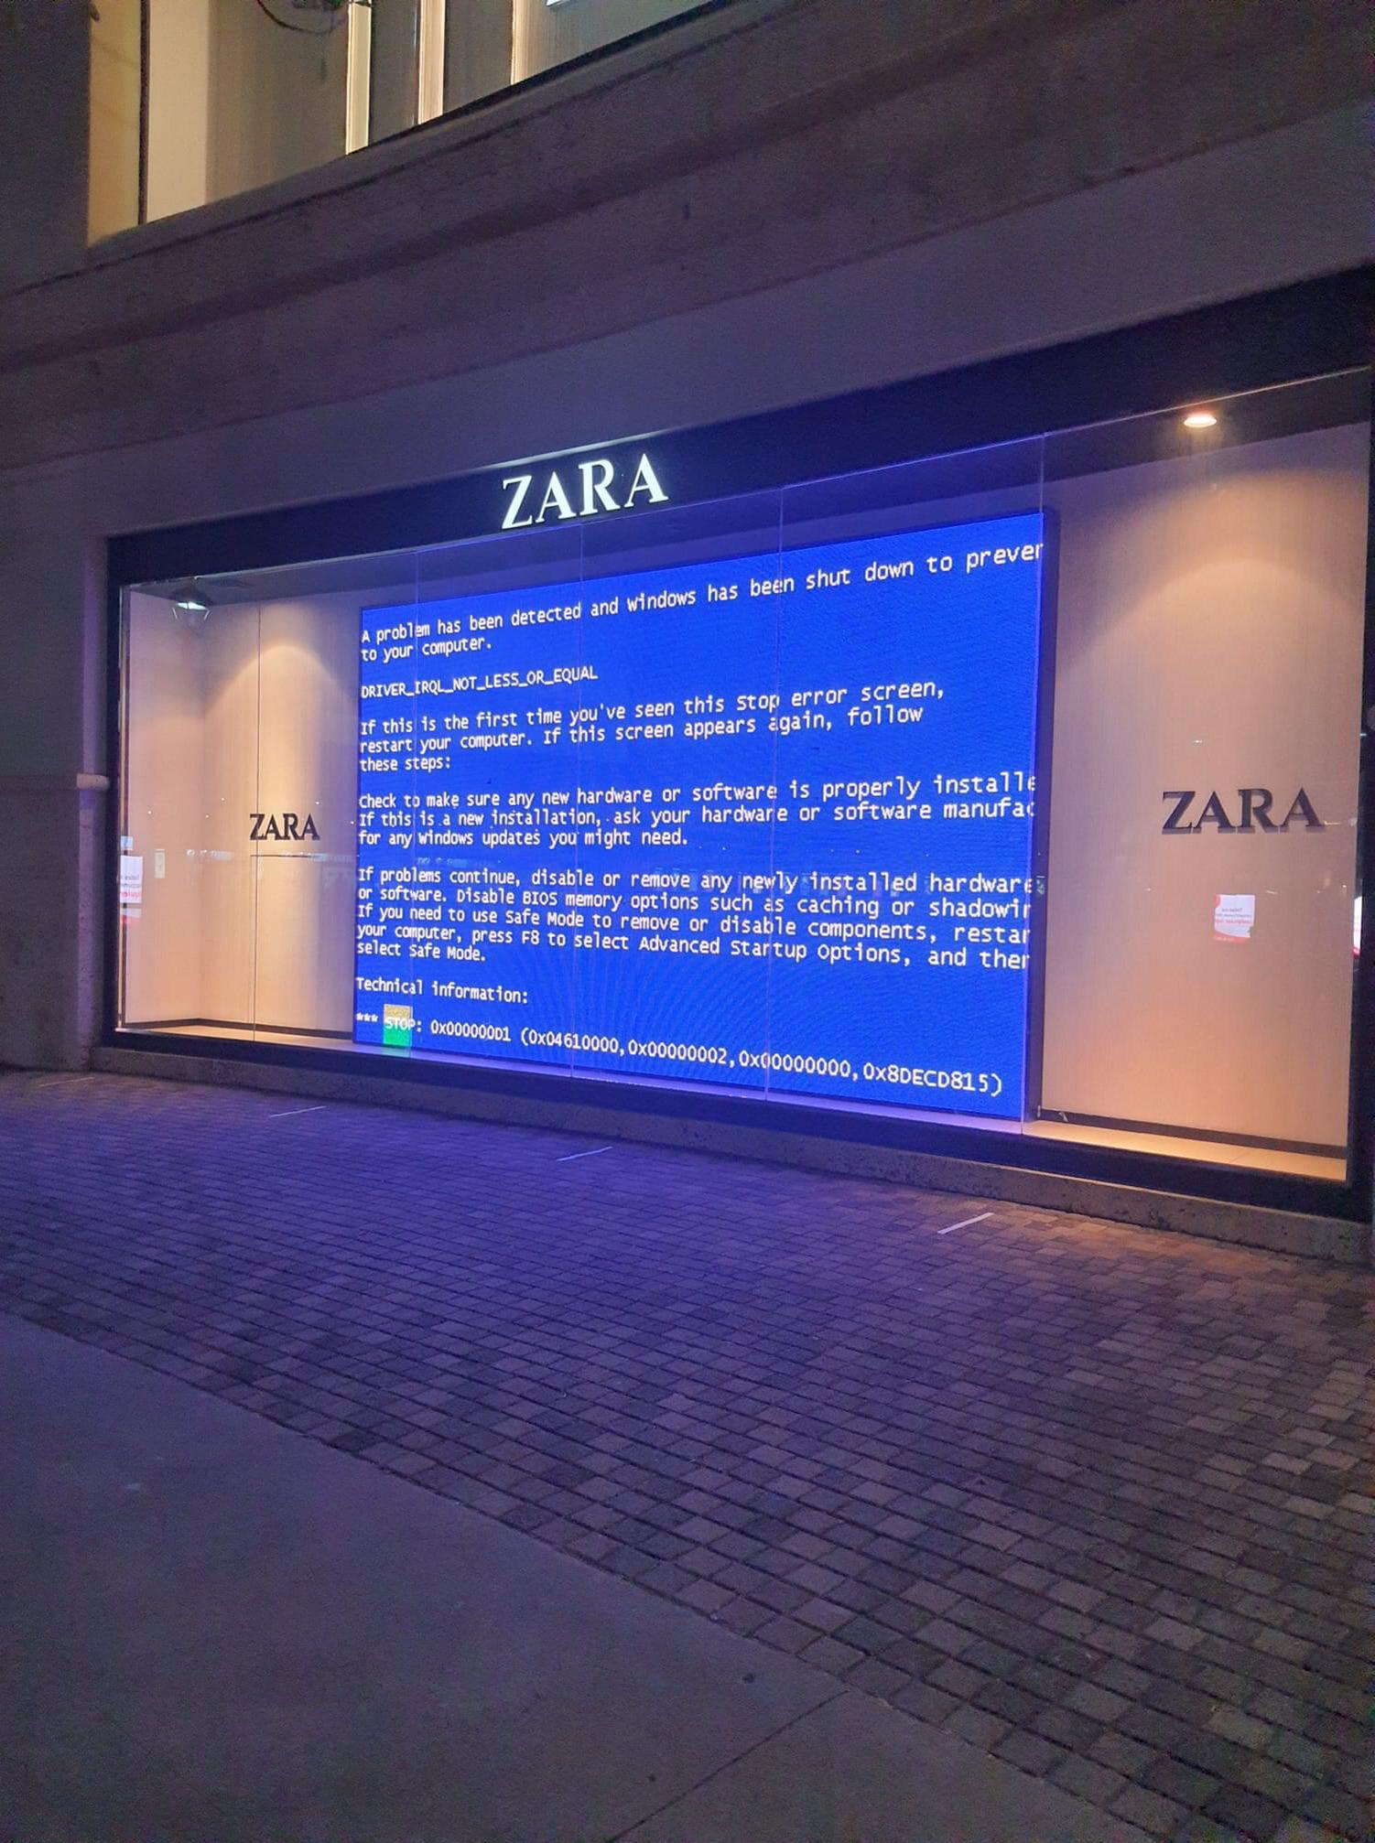
About Your Instructor
Zara Ahmad-Post
Security Data Science @ DigitalOcean
Adjunct Faculty @ University of Arizona
Founder, Director of R&D @ Z Collective

Slide 3
Goals for this Course
Compare and contrast
Compare and contrast the major communities and corporations in the cloud industry
Gain
Gain familiarity with major cloud-hosted and cloud-native technologies
Evaluate
Plan and evaluate cloud-hosted and cloud-native architectures
Describe
Describe security and privacy concerns in cloud environments
Make
Make sound recommendations regarding cloud technologies and articulate the rationale behind cloud business decisions

Slide 4
Syllabus Overview
Unit 1: Cloud Fundamentals
Unit 2: Cloud-Native Technologies
Unit 3: Special Topics
MLOps
Serverless
Compute
Database
Network
Microservices
Infrastructure as Code
Kubernetes
DevOps
Storage

Slide 5
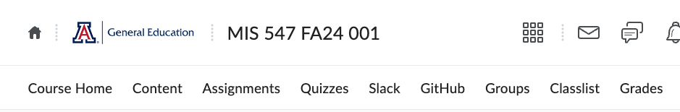
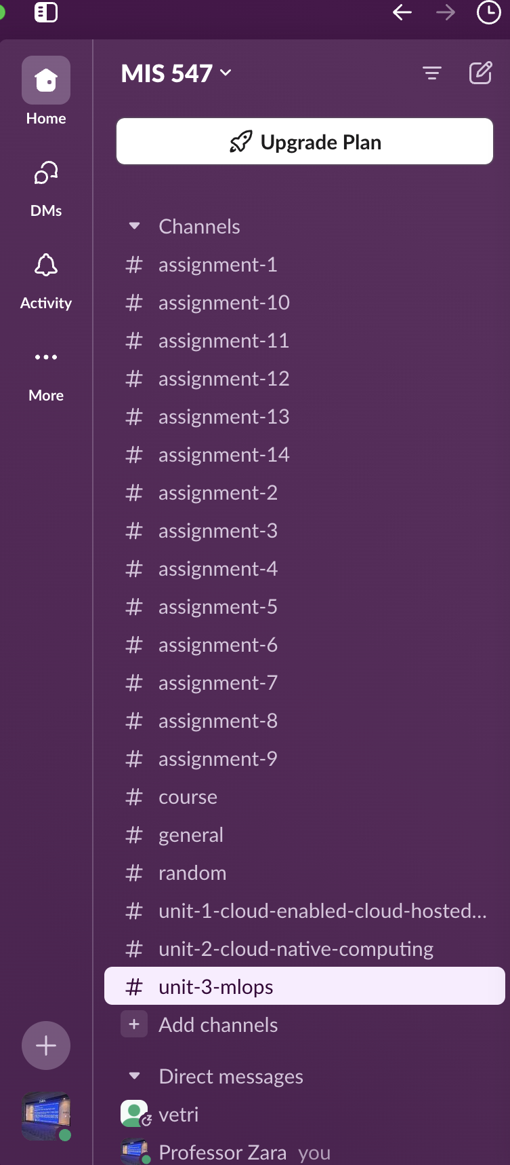
Communication Guidelines
We will be using Slack for communication (see D2L navbar)
Please post questions in Slack in public channels
We have a Slack citizenship guide in D2L
If a personal request or grading question, email or DM me is fine

Slide 6
Extra Credit Opportunities
Debugging
Slack participation
Community involvement
Course evaluations and surveys
Extra Credit
See Syllabus or Getting Started sections in D2L for details

Slide 7
Policy on Usage of Generative AI
You may not use generative language models to create any written materials in this course.
You may use CoPilot, but…
<soapbox>Zara’s Disclaimers about Using Generative AI </soapbox>

Slide 8
Due This Week
1. Course pre-assessment
2. Assignment 1- Sunday at midnight
3. Quiz 1- Sunday at midnight

Slide 9
Lecture 1: WHAT IS THE CLOUD

Slide 10

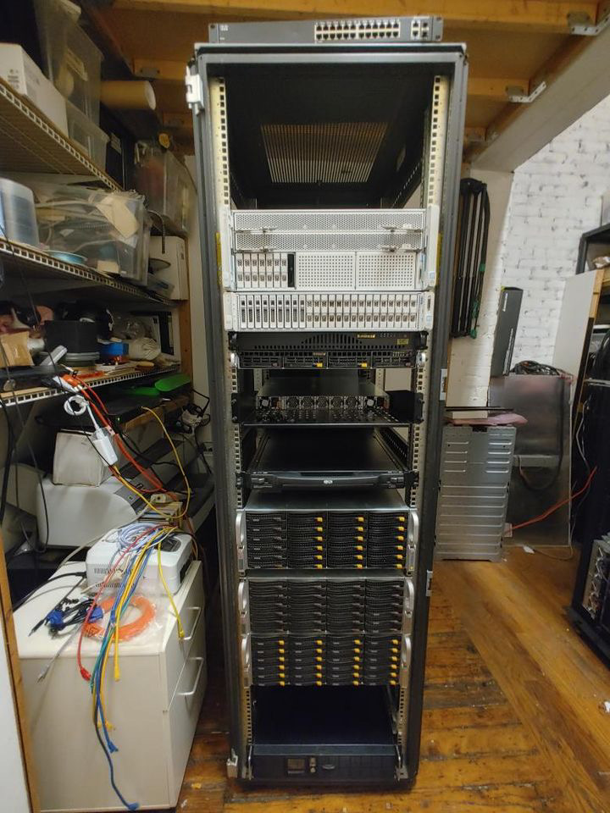
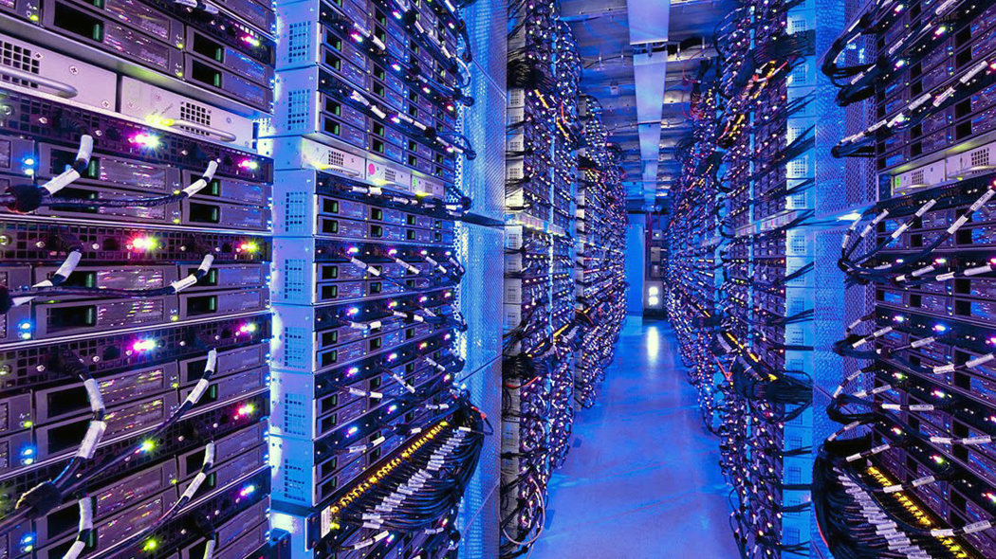
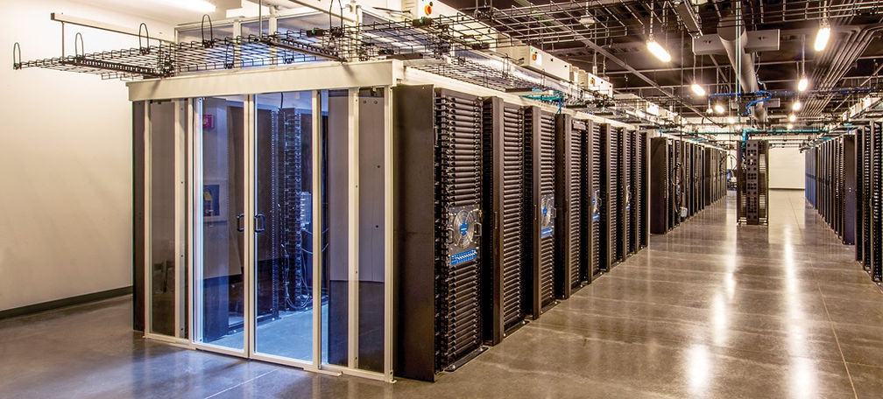
Someone else’s computer
This Photo by Unknown Author is licensed under CC BY-NC-ND

Slide 11
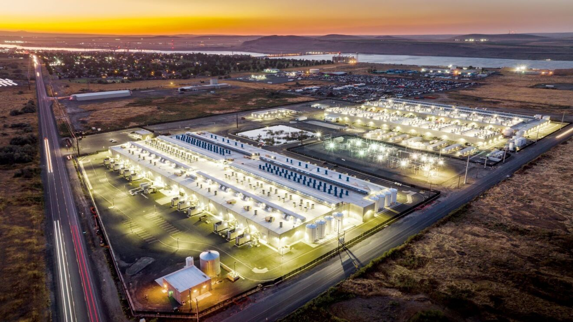
Someone else’s computer

Slide 12
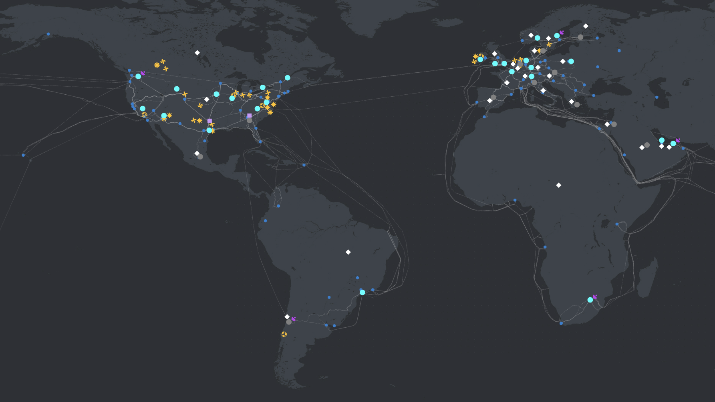
Someone else’s computer: Azure global infrastructure
Notes:
Azure global infrastructure

Slide 13
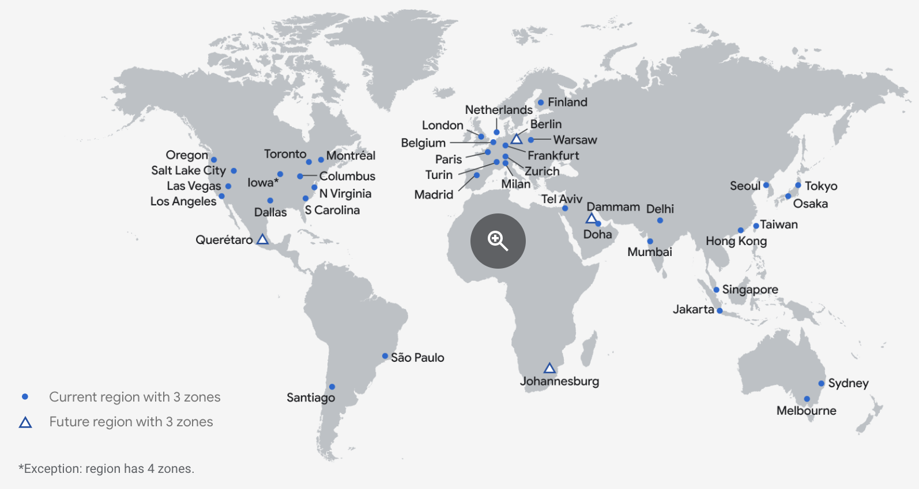
Someone else’s computer: Google Cloud Platform global infrastructure
Notes:
GCP global infrastructure

Slide 14
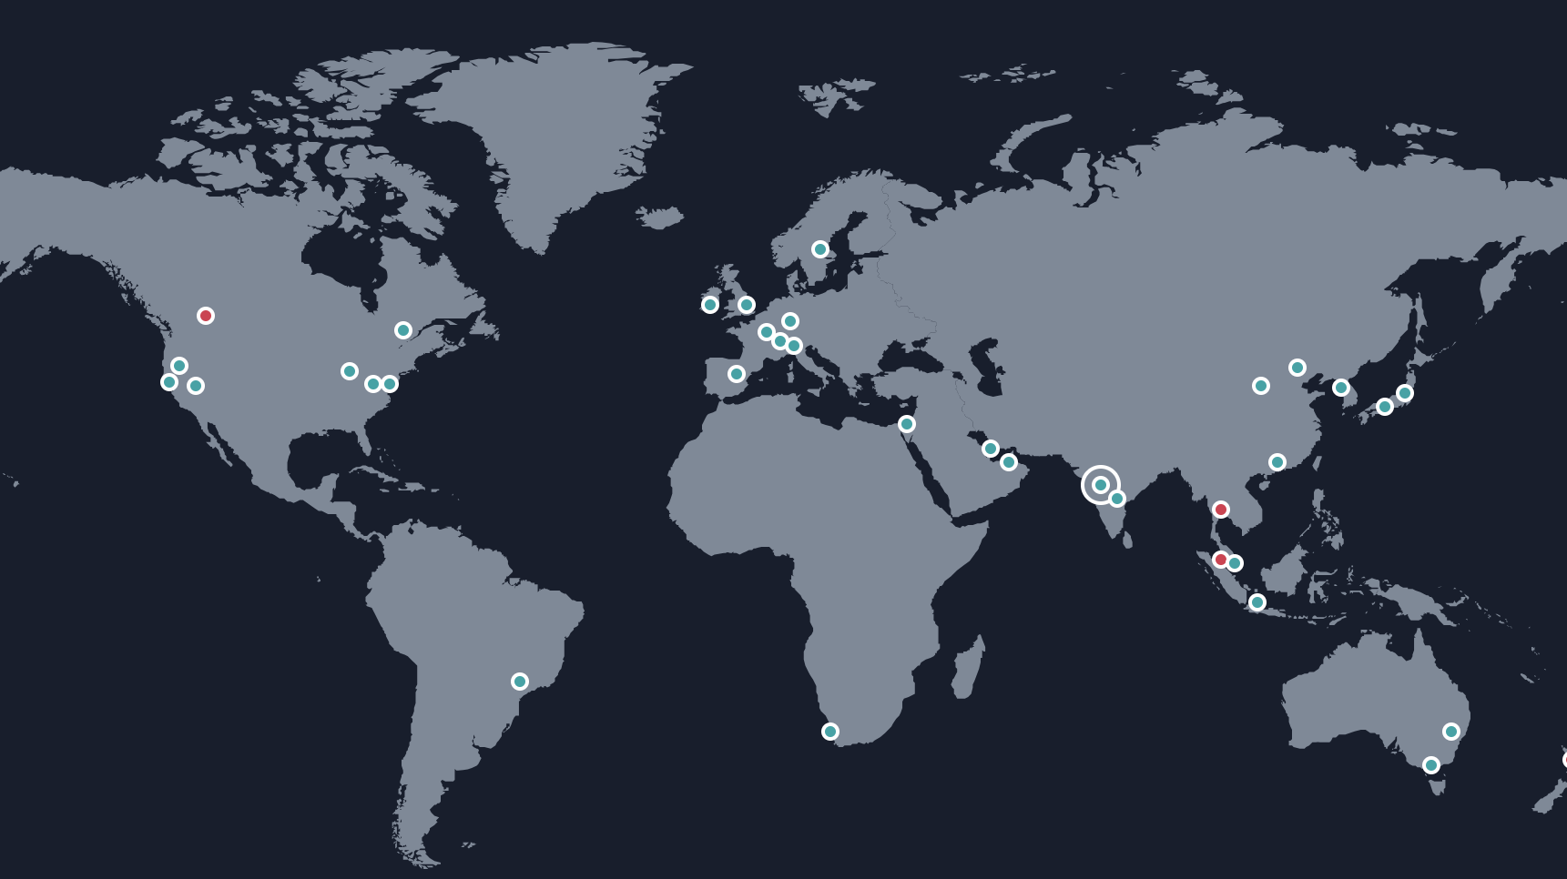
Someone else’s computer: AWS global infrastructure
Notes:
AWS global infrastructure

Slide 15
What is this Class Really about?
Massive global infrastructure, global workforces, hundreds of services… How do we leverage all of this?
What does this mean for us as product managers, project managers, data folk, developers, security experts, privacy champions, global citizens?
How do we turn datacenters into Netflix? How do we turn GPUs into OpenAI?
This class will equip you the knowledge to leverage cloud computing services.
We can’t cover everything… find continuing education resources that work for you!

Slide 16
DEFINING CLOUD COMPUTING
NIST Characteristics of Cloud Computing
On-demand usage (self-service usage)
Ubiquitous* access
Multitenancy (resource pooling)
Elasticity
Measured Usage
Resiliency

Slide 17
DEFINING CLOUD COMPUTING
ON-DEMAND USAGE
A cloud consumer can autonomously access cloud-based IT resources, and self-provision these resources.
The customer doesn’t have to interact with the cloud provider.
They can access their cloud accounts through a web self-service portal to view their cloud services, monitor their usage, and provision and de-provision services.

Slide 18
DEFINING CLOUD COMPUTING
UBIQUITOUS ACCESS*
This is the ability for a cloud service to be widely accessible.
It requires support for a range of devices, transport protocols, interfaces, and security technologies.
In the case of public clouds, access is facilitated via the internet; in the case of private clouds, it’s facilitated through a LAN.

Slide 19
DEFINING CLOUD COMPUTING
MULTITENANCY
Multiple customers can share physical resources using a multi-tenant model.
This model assigns and reassigns physical and virtual resources based on demand.
Multi-tenancy allows customers to share the same infrastructure while maintaining privacy and security.
A cloud provider pools its IT resources to serve multiple customers by using multitenancy models that rely on the use of virtualization technologies.

Slide 20
DEFINING CLOUD COMPUTING
ELASTICITY
The automated ability of a cloud to scale resources as needed in response to runtime conditions or as predetermined by the cloud consumer or cloud provider.

Slide 21
DEFINING CLOUD COMPUTING
MEASURED USAGE
The cloud provider can charge a cloud consumer only for the resources they use and/or for the timeframe during which access to the resource was granted.
Measured usage can apply to billing, but also to general monitoring of resources and usage reporting.

Slide 22
Defining Cloud Computing
RESILLIENCY
A form of failover that distributes redundant implementations of IT resources across physical locations.
This can also refer to the overall ability of a service to recover quickly from any disruption, measured by how fast servers, databases, and networks restart and recover after damage.

Slide 23
Defining Cloud Computing: Cloud Resources
Compute
Database
Storage
Networking
Security

Slide 24
Defining Cloud Computing: Cloud Computing Models
Software as a Service
Platform as a Service
Infrastructure as a Service

Slide 25






Software as a service
Managed by a service provider
Consumers don’t worry about the underlying infrastructure, maintenance, or management
End-user applications where users only think about how to use and benefit from the product or service

Slide 26

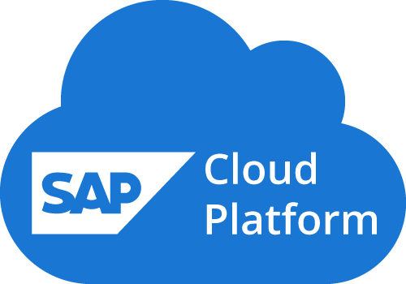


Platform as a service
An environment for engineers to create and deploy applications
Devs don’t worry about the backend infrastructure
Devs don’t configure or manage servers, DBs, datacenters, etc.
PaaS gives more control than SaaS
Notes:
. WordPress functions as PaaS when develoeprs get involved to build different features and functions into the blog.

Slide 27

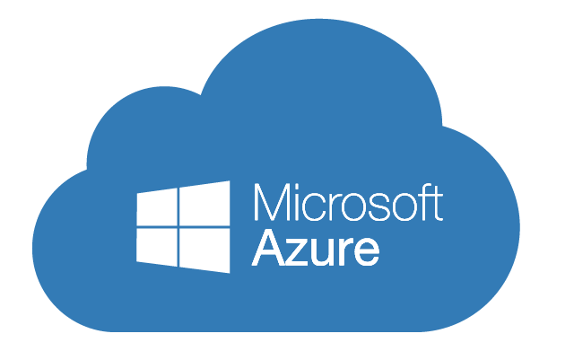
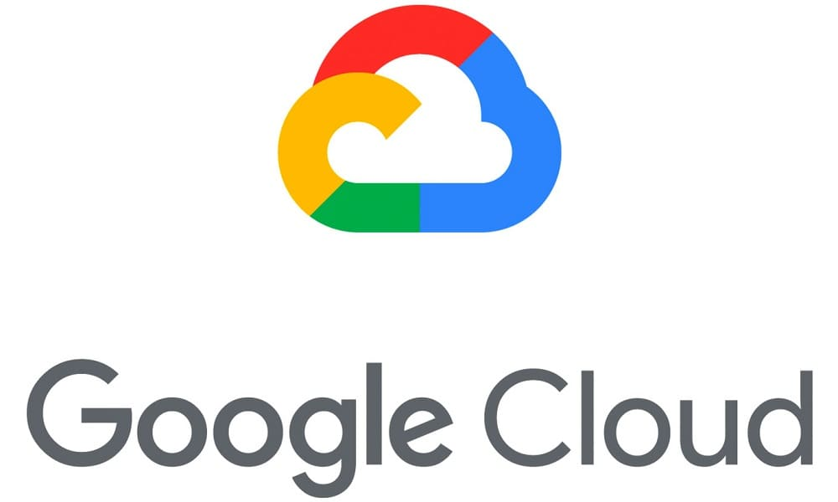

Infrastructure as a service
IaaS == physical/virtual IT infrastructure that a CSP offers
Configure, customize, and maintain a virtual version of your server room/ IT infrastructure
Compute, storage, networking
Requires more engineering than SaaS/PaaS
Most flexibility and customizability

Slide 28
Defining Cloud Computing: Cloud deployment models
Public Cloud
Hybrid
Private cloud
Multi-cloud
Deployment:
The process of setting up computer and network systems so they are ready for use.
The key difference in deployment models is how much control you have over the system.

Slide 29




Public Cloud
Public Cloud Service Provider
Servers
Databases
Enterprise A
Enterprise A Network

Slide 30


Public Cloud
Enterprise B
Public Cloud Service Provider
Enterprise B Network
Enterprise C
Enterprise A
Enterprise C Network
Enterprise A Network

Slide 31

Private Cloud
Private Cloud
Servers
Databases
Enterprise
Enterprise network extended via VPN*

Slide 32
Hybrid Cloud
Public Cloud Service Provider
Private Cloud
Enterprise Network

Slide 33


Public Cloud B
MULTI Cloud
Public Cloud A
Public Cloud C
Enterprise

Slide 34

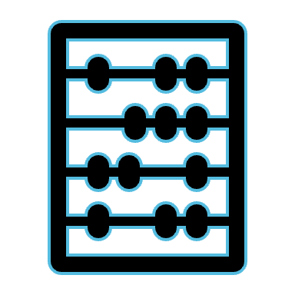




Six Advantages of Cloud Computing

Slide 35
Six Advantages of Cloud Computing
Trade capital expense for variable expense

Slide 36
Six Advantages of Cloud Computing
Trade capital expense for variable expense
Benefit from massive economies of scale

Slide 37
Six Advantages of Cloud Computing
Trade capital expense for variable expense
Benefit from massive economies of scale
Stop guessing capacity

Slide 38
Six Advantages of Cloud Computing
Trade capital expense for variable expense
Benefit from massive economies of scale
Stop guessing capacity
Increase speed and agility

Slide 39
Six Advantages of Cloud Computing
Trade capital expense for variable expense
Benefit from massive economies of scale
Stop guessing capacity
Increase speed and agility
Stop spending money running data centers

Slide 40
Six Advantages of Cloud Computing
Trade capital expense for variable expense
Benefit from massive economies of scale
Stop guessing capacity
Increase speed and agility
Stop spending money running data centers
Go global in minutes

Slide 41
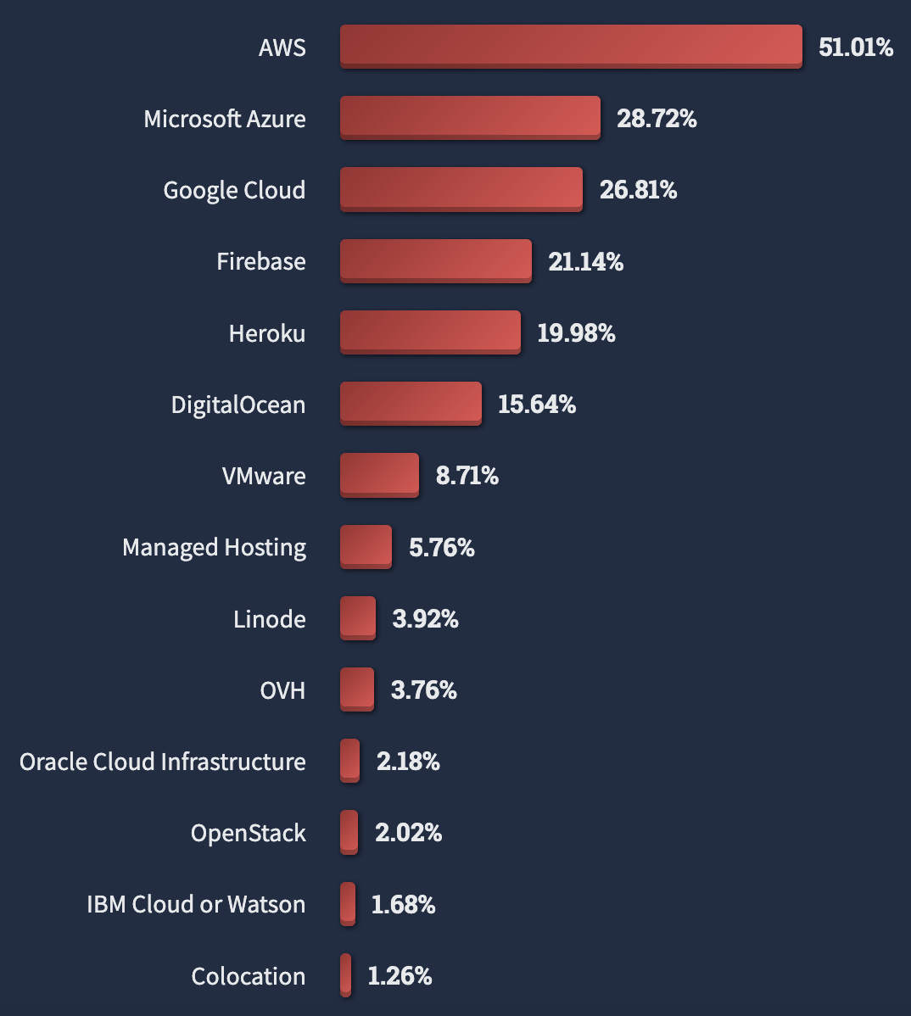
Major Players in Cloud Computing
Source: StackOverflow Developer Survey

Slide 42
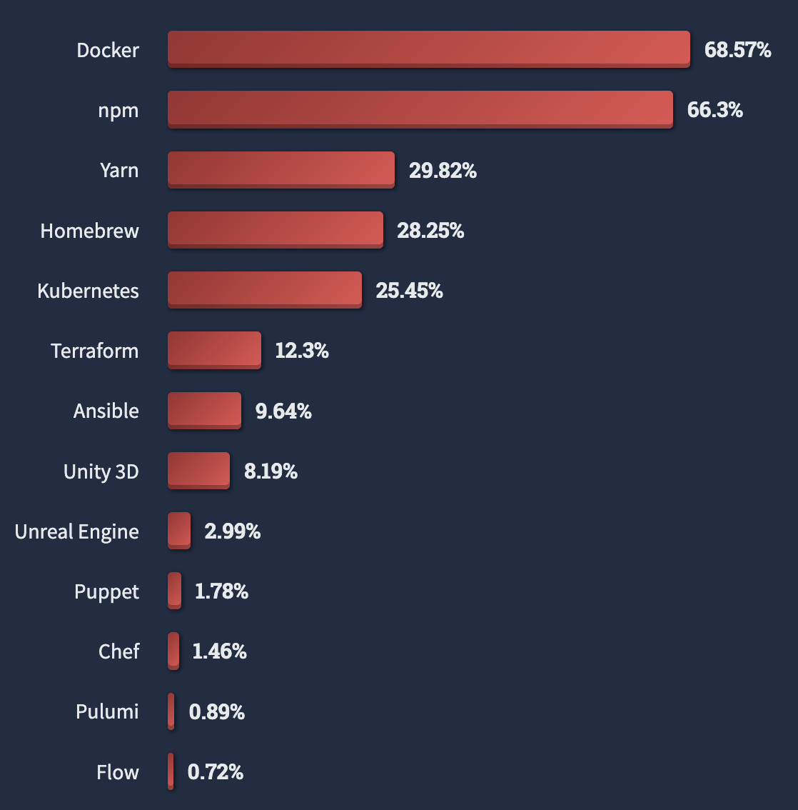
Cloud IS DRIVING TECHNOLOGY ADOPTION EVERYWHERE
Source: StackOverflow Developer Survey

Slide 43
Macroeconomic Landscape: 2023
Tech market downturn
Cost savings are critical
Staffing reduction

Slide 44
Macroeconomic Landscape: 2024
AI
Uncertain Market
Security Investment

Slide 45
REFERENCES
StackOverflow Developer Survey. 2023. Available: https://survey.stackoverflow.co/2023/

Slide 46
LAND ACKNOWLEDGEMENT STATEMENT
We respectfully acknowledge the University of Arizona is on the land and territories of Indigenous peoples. Today, Arizona is home to 22 federally-recognized tribes, with Tucson being home to the O’odham and the Yacqui. Committed to diversity and inclusion, the University strives to build sustainable relationships with sovereign Native Nations and Indigenous communities through education offerings, partnerships, and community service.

